Slide 1

RAGHU ENGINEERING COLLEGE (AUTONOMUS) Affiliated to JNTU GURAJADA, VIZIANAGARAM Approved by AICTE, Accredited by NBA, Accredited by NAAC with A+ Grade Computer Science Engineering (Data Science)
MENTOR:
BATCH NO: 8
TEAM MEMBERS:
Y.Mahesh (21981A4463)
K.Preethi Karen (21981A4430)
P.Vinay (21981A4446)
P.Bindu (21981A4448)
Mr.V.Govinda Rao
ASSISTANT PROFESSOR

Slide 2
Unlocking HR Insights

Slide 3
Introduction
In today’s competitive business landscape, Human Resources (HR) departments are increasingly tasked with strategic decision-making that directly impacts organizational performance. Traditional, intuition-based approaches are being superseded by data-driven methodologies, enabling HR professionals to gain deeper insights into workforce dynamics and optimize human capital management. This project, "Unlocking HR Insights Through Data-Driven Attendance Analysis," aims to leverage the power of data analytics to transform raw employee attendance data into actionable intelligence, specifically focusing on patterns, trends, and key performance indicators related to attendance. The primary purpose of this project is to develop an interactive and insightful Power BI dashboard that enables HR Generalists to effectively analyze employee attendance data.

Slide 4
ABSTRACT
Human Resource (HR) data analytics is a rapidly growing field that leverages data-driven insights to optimize workforce management and decision-making. This project addresses the critical need for data-driven decision-making in Human Resources by developing an interactive Power BI dashboard to analyze employee attendance patterns. Leveraging publicly available real-world datasets, specifically attendance sheets from different platforms, this initiative aims to empower HR Generalists with actionable insights regarding employee retention, sick leave trends, work from home (WFH) and work from office (WFO). This project demonstrates the application of HR analytics to improve workforce management by providing a robust framework for continuous updates and enhancements. The dashboard enables HR professionals to strategically plan key events, implement targeted retention strategies, and address factors contributing to sick leave percentages. By quantifying and visualizing attendance data, this project provides a foundation for enhancing employee satisfaction, well-being, and overall organizational effectiveness.

Slide 5
Literature survey
Title | Methodology | Authors
HR Analytics -empowering organization | Predictive data analytics. | Ansho kuriakose.
HR analytics : A modern tool in HR | Statistical data analysis, modelling, machine learning, data mining. | Dr. Abdul Quddus Mohammed.
Effects of HR analytics on HRM Practices. | Integrative review, Literature review. | Samuel bangura
The Role of HR Analytics in Enhancing Organizational Performance | predictive modeling and machine learning. | Delfi Kurnia Zebua.
HR Analytics for Data-Driven Employee Attrition Management | descriptive, diagnostic, predictive, and prescriptive analysis. | Jessien Law Jia Xin, Nomahaza Mahadi.

Slide 6
Existing System
Focuses on identifying skilled individuals who contribute significantly to Return of Investment for the organization by considering several factors which help for a better understanding of the individual by predictive analysis.
Pinpointing employees or departments that require additional training or support. Developing targeted career development plans based on performance data.
This implementation can boost up the economic growth of a company as it uses simple dashboards for performance and Identifying patterns in employee performance over time.
This type of predictive methodology is important because during an economic crisis for any company such as times of recession it is important to study and determine the fate of a company.

Slide 7
Drawbacks
The Employee Performance Analysis project focuses more on performance data rather than attendance patterns, which limits its scope in understanding employee retention and satisfaction.
Simple dashboards may not provide in-depth insights into attendance patterns, reasons for leave, or WFH/WFO trends.
Requires knowledge of machine learning and predictive analytics, which might not be necessary for basic HR insights.
Implementing predictive models and ensuring their accuracy can be challenging and time-consuming.
lack the flexibility to adapt to changing business needs or new data insights.

Slide 8
Proposed System:
Leverages Power BI for interactive and dynamic dashboards. Analyzes employee attendance data over the last 3 months.
Aims to provide actionable insights for data-driven decision-making.
Focuses on understanding attendance patterns, retention strategies, sick leave analysis, and WFH/WFO trends.
Emphasizes improving employee satisfaction and well-being.
Includes detailed data transformation and DAX calculations for robust analysis.
Focus on creating visually appealing and intuitive representations of the insights for end-users

Slide 9
Key Advantages
Covers a wider range of HR metrics beyond just attrition and performance.
Provides detailed information on attendance, leave patterns, and work arrangements.
Empowers HR to develop targeted interventions and strategies. Focuses on employee well-being and satisfaction.
Power BI dashboards enable flexible exploration and analysis.
Can be easily updated and expanded to incorporate new data and insights.

Slide 10
Existing system Vs Proposed system
Feature | Existing System | Proposed System
Focus | Attrition prediction, performance decline | Comprehensive HR analytics (attendance, leave, WFH/WFO)
Data Analysis | Predictive analysis | Descriptive, diagnostic, and potentially predictive analytics
Visualization | Simple dashboards | Interactive Power BI dashboards
Scope | Limited | Comprehensive
Actionability | Limited | High
Technology | Potentially unspecified | Power BI, DAX, Power Query

Slide 11
Implementation
The methodology employed in this study includes:
Data Collection:
Collect HR-related data from various sources.
Ensure data is in a usable format for further processing.
Data Transformation:
Use Power Query Editor in power BI to transform the data into required format.
Performs operations like data reshaping, combining data sets, and applying transformations as needed.
Data cleaning:
Removing the unwanted columns and missing values or errors in data.
Ensure the data adheres to the requirements for analysis.

Slide 12
Matrix creation:
Leverage DAX (Data Analysis Expressions) in power BI to build dynamic metrices for computations and aggregations.
Create calculated columns, measures, and custom metrics as needed insights.
Dashboarding:
Designing user-friendly dashboards and reports using Power BIs visualization tools.
Present insights effectively through charts, graphs, and interactive elements.
Final output:
Provide a robust framework for continuous updates and improvements to HR analytics process.

Slide 13
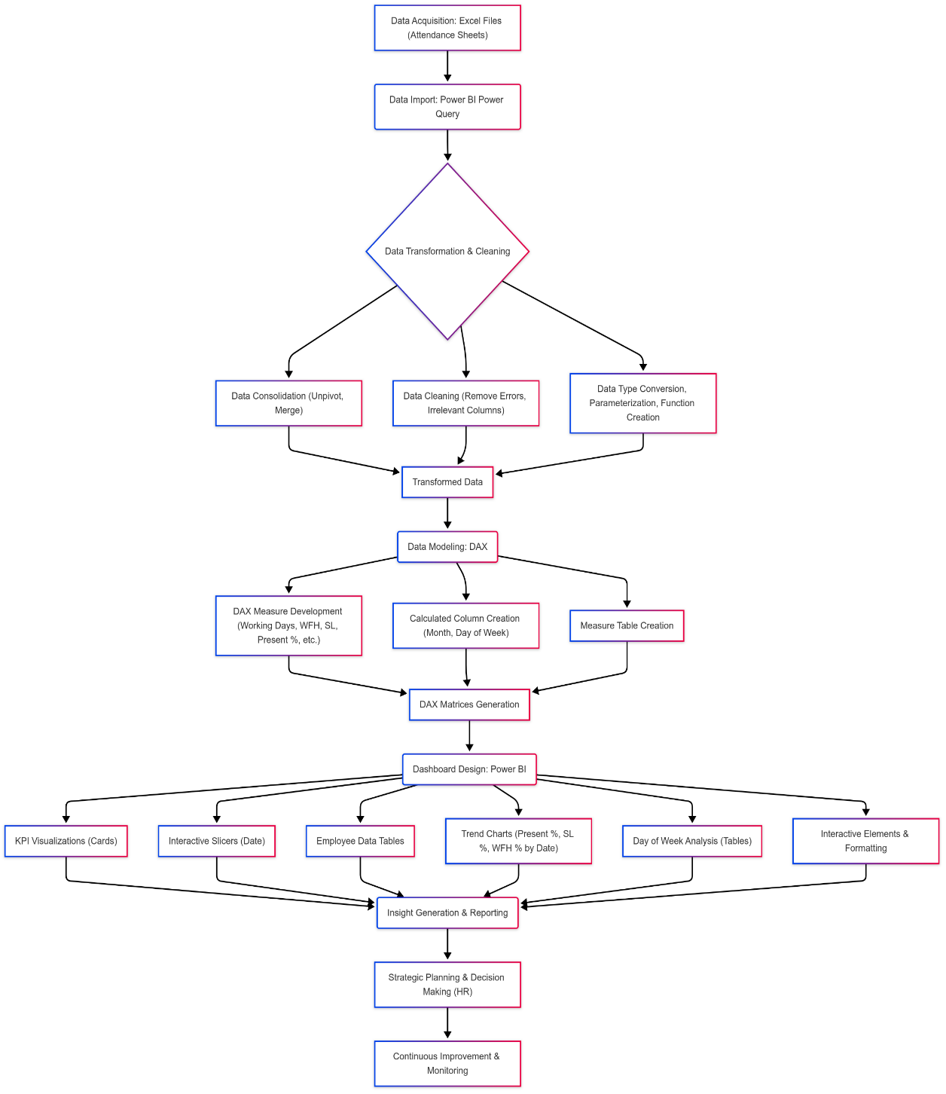
Workflow diagram

Slide 14
Timelines
Stage | Deliverables | Timeline
Stage 1: Data Collection | Comprehensive understanding of project goals, literature review table, and data collection sources. | 1 weeks
Stage 2: Data transformation | Template creation, creating custom functions, invoking functions on data. | 3 weeks
Stage 3: Creating matrix using DAX | Adding required columns, statistical operations on columns, creating measure table. | 3 weeks
Stage 4: Dashboarding | Data visualization using Power BI. | 3 weeks
Stage 5: Documentation | Prepare project report, including abstract, methodology, results, and future work. | 2 week

Slide 15
Stage 1: Data Collection
Dataset Names and Sources:
Dataset Name: Attendance Sheet of Employee.
Source: Publicly available real-world datasets from platforms like Atliq Technologies.
Attributes: Employee Code, Employee Name, April ,May, June Employee Attendance.
Supplementary Data: Attendance Key sheet.
Algorithms/Tools/Techniques:
MS Excel: Data storage.
Data Analytical Expression (DAX): Statistical Analysis
Power BI: Data Visualizations.

Slide 16
Stage2: Data Transformation (Power Query)
Key Steps:
Data Import (Excel)
Data Transformation (Consolidation, Restructuring)
Power Query Editor (Cleaning, Shaping)
Template Creation (Reusable Transformations)
Unpivoting Date Columns
Automating Summary Column Removal
Creating Parameters & Functions
Enabling/Disabling Data Load
Load data into Power BI
Benefits: Automated, efficient, and repeatable data preparation.

Slide 17
Stage 3: DAX Matrix Creation
Metrics: Metrics is nothing but a quantitative assessment which helps to make decisions.
Measure Table: Creating a dedicated table for DAX measures for better organization.
Key DAX Measures:
Total Working Days (excluding holidays and weekends)
WFH Count (including partial WFH)
Present Days (including WFH)
Present Percentage
Month Column (for analysis by month)

Slide 18
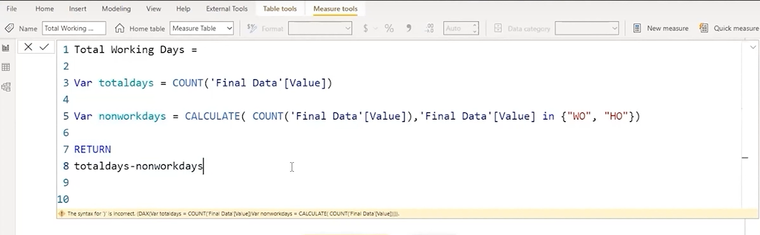
Calculating Total Working Days with DAX
The following DAX measure calculates the total working days, excluding holidays (HO) and weekends off (WO):

Slide 19
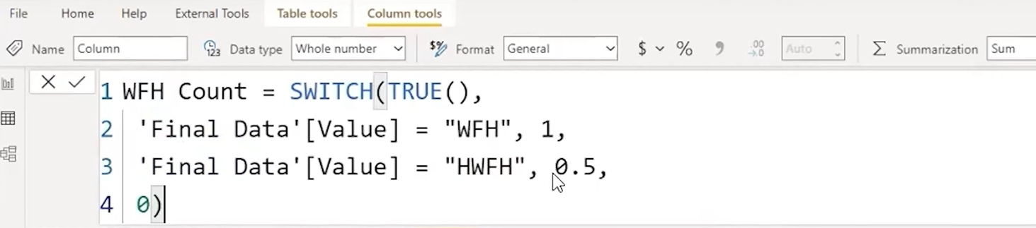
Calculating WFH Count
We need to assign numerical values to WFH and HWFH entries to incorporate them into our present-day calculation. We'll create a calculated column named "WFH Count" in the finalData table. The following DAX expression creates the "WFH Count" column:

Slide 20

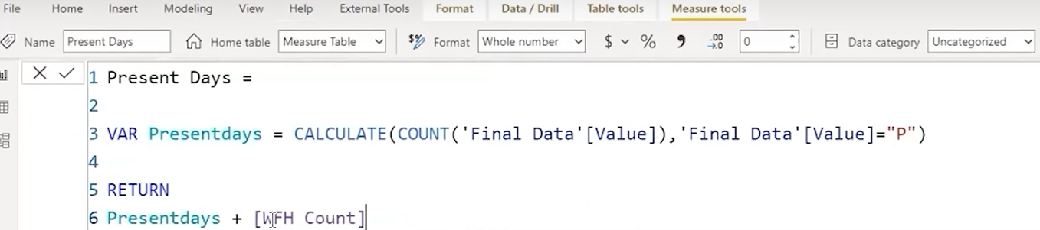
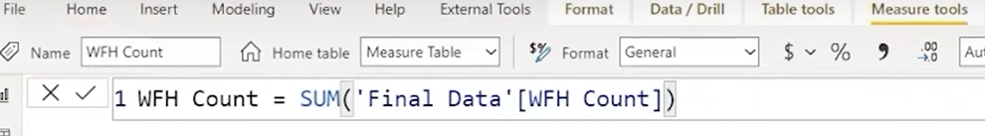
Create a DAX measure to calculate the total present day, including WFH and HWFH:
Now, create a DAX measure to sum up the values in the "WFH Count" column:

Slide 21
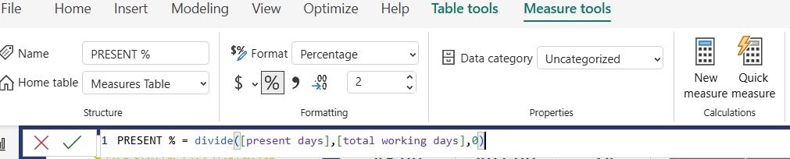
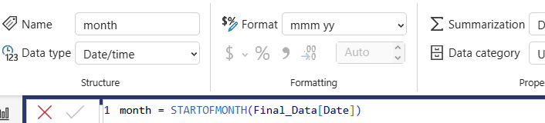
To facilitate future analysis and reporting, it’s beneficial to have a dedicated column for month in final data. This following DAX will create month column
Finally, create a DAX measure to calculate the present percentage

Slide 22
Stage 4: Dashboarding
Creating Key Performance Indicator (KPI) Cards
Developing Interactive Slicers
Building Employee Data Tables
Visualizing Attendance Trends Over Time
Analyzing Attendance by Day of Week
Curating the HR-Focused Dashboard

Slide 23


KPI Presence Percentage
Select “card” visual form visualization pane.
Drag and drop the presence percentage into the card.
KPI: Sick Leave Percentage
DAX formula for sick leave percentage is SL%= DIVIDE([SL Count],[total working days],0)
Do the same card visualization as presence percentage.

Slide 24
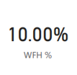

KPI: Work from Home percentage
WFH % = DIVIDE([WFH Count],[present days],0)
Select “card” visual form visualization pane.
Drag and drop the WFH percentage into the card.
KPI: Employee count
DAX formula Employee Count = DistinctCount(FinalData[“Employee_Code”])
Do the same card visualization as presence percentage.

Slide 25
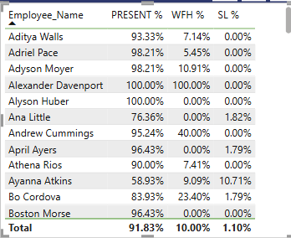

Interactive Date Slicer
Drag Date field into slicer visual
Change the styles to tile. This slicer is dynamic data filtering
Employee Attendance Summary
Select "Table" visual
Drag and drop relevant measures and fields.
This table's role in providing a quick overview of employee attendance.

Slide 26
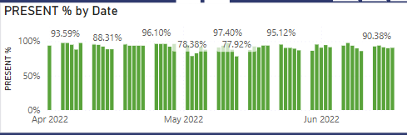
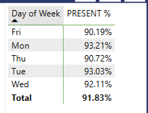
Present Percentage Trend
Select "Clustered column chart" visual.
Drag "Date" into Axis and "Present %" into Values.
Present Percentage by Day of Week
Create "Day of Week" calculated column.
Day of week = FORMAT(‘finalData’[Date],”dddd”)
Drag "Day of Week" and "Present %" into table visual.

Slide 27
Visualizing Sick Leave and WFH Trends
These visualizations follow the same pattern as the "Present %" visualizations.
SL % by Date (Chart)
SL % by Day(Chart)
WFH % by Date (Chart)
WFH % by Day (Chart)

Slide 28
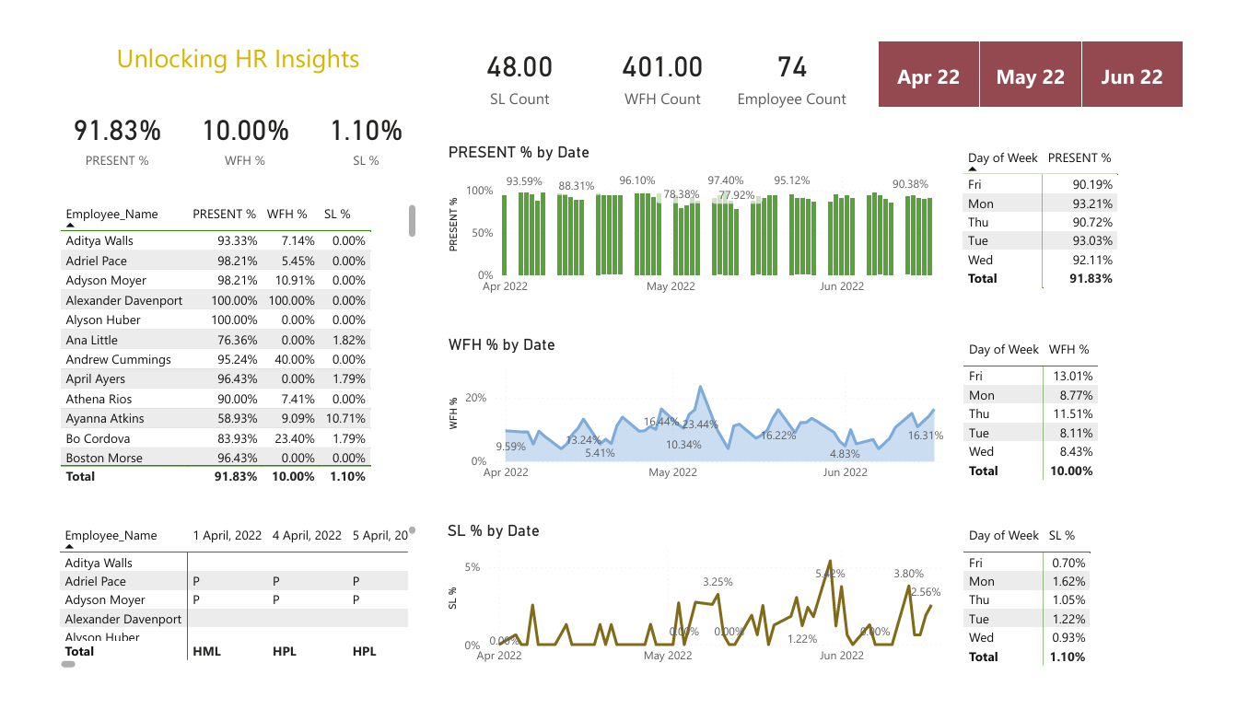
Final Dashboard

Slide 29
Paper Publication Status
The International Journal of Emerging Technologies and Innovative Research (JETIR) aims to explore advances in research pertaining to applied, theoretical and experimental Technological studies. The goal is to promote scientific information interchange between researchers, developers, engineers, Faculty, students, and practitioners working in and around the world.
JETIR is Scholarly open access journals, Peer-reviewed, and Refereed Journals, High Impact factor 7.95 (Calculate by google scholar and Semantic Scholar | AI-Powered Research Tool), Multidisciplinary, Monthly, Indexing in all major database & Metadata, Citation Generator, Digital Object Identifier(DOI) with Open-Access Publications.
Currently this research work has been selected for publication in JETIR, and the documentation process according to the JETIR format. The focus remains on ensuring high-quality contributions, including original research paper, review articles, and case studies, aligned with recent technologies advancements.

Slide 30
Conclusion
Data-Driven Decisions: The dashboard will empower HR to make informed decisions regarding:
Employee retention strategies.
Targeted interventions for improving attendance (Offering flexible working hours and employee wellness programs).
Optimizing resource allocation.
Improved Employee Experience:
By understanding employee needs and patterns, HR can create a more supportive and productive work environment.
Strategic Planning: Insights into attendance and leave patterns will facilitate better planning of key events.

